Slide 1
Basic Concepts of Economics
Definition and Scope; Subject Matter of Economics; Central Economic Problems; Microeconomics vs. Macroeconomics; Different Economic Systems; Economics and Engineering

Slide 2
Learning Objectives
By the end of this lecture, students will be able to:
1. Define economics and explain its scope.
2. Describe the subject matter of economics.
3. Explain the central economic problems faced by societies.
4. Differentiate between microeconomics and macroeconomics.
5. Compare different economic systems.
6. Understand the relationship between economics and engineering.
7. Apply economic concepts to real-life decision making.

Slide 3
Introduction
Economics is one of the most important social sciences because it studies how individuals, firms, and governments make choices when resources are limited.
Every day people make economic decisions such as:
What to buy?
How much to save?
What to produce?
Which technology to use?
How to allocate limited resources?

Slide 4
Introduction (Contd.)
Economics helps us understand:
Production
Consumption
Distribution
Resource allocation
Economic growth
Welfare of society

Slide 5
What is Economics?
Meaning of Economics
The word “Economics” comes from the Greek words:
“Oikos” = Household
“Nomos” = Management
Therefore, economics originally meant “household management.”
Today, economics studies how society manages scarce resources.

Slide 6
Definitions of Economics
Adam Smith (Wealth Definition)
“An inquiry into the nature and causes of the wealth of nations.”
Main Focus
Production of wealth
Distribution of wealth
Economic growth
Limitation
Focused mainly on wealth rather than human welfare.

Slide 7
Definitions of Economics (Contd.)
Alfred Marshall (Welfare Definition)
“Economics is a study of mankind in the ordinary business of life.”
Main Focus
Human welfare
Material well-being
Wealth as a means to welfare
Importance
Shifted focus from wealth to human welfare.

Slide 8
Definitions of Economics (Contd.)
Lionel Robbins (Scarcity Definition)
“Economics is the science which studies human behavior as a relationship between ends and scarce means which have alternative uses.”
Key Concepts
Unlimited wants
Scarce resources
Alternative uses
Choice
This is the most widely accepted modern definition.

Slide 9
Definitions of Economics (Contd.)
Samuelson’s Definition
“Economics is the study of how societies use scarce resources to produce valuable commodities and distribute them among different people.”
Key Focus
Resource allocation
Production
Distribution
Efficiency

Slide 10
Scope of Economics
The scope of economics refers to the areas covered by economics.
Two Main Branches
Microeconomics
Macroeconomics
Economics also includes:
Consumption
Production
Exchange
Distribution
Public finance
International trade
Development economics
Environmental economics

Slide 11
Nature of Economics
Economics is:
1. A Social Science
Studies human behavior.
Examines economic relationships.
2. A Positive Science
Explains “what is.”
Example: Inflation increases prices.
3. A Normative Science
Explains “what ought to be.”
Example: Government should reduce unemployment.
4. A Science of Choice
Resources are scarce.
Choices must be made.

Slide 12
Subject Matter of Economics
1. Consumption
2. Production
3. Exchange
4. Distribution
5. Public Finance
6. Economic Development
7. Social Welfare

Slide 13
Subject Matter of Economics (Contd.)
The subject matter of economics mainly deals with:
1. Consumption
Study of:
Wants
Utility
Consumer behavior
Demand
Example
Why do consumers buy more products when prices fall?

Slide 14
Subject Matter of Economics (Contd.)
2. Production
Study of:
Production process
Factors of production
Cost analysis
Supply
Factors of Production
Land
Labor
Capital
Entrepreneurship

Slide 15
Subject Matter of Economics (Contd.)
3. Exchange
Study of:
Markets
Price determination
Trade
Money and banking
Example
How are prices determined in the market?

Slide 16
Subject Matter of Economics (Contd.)
4. Distribution
Study of:
Wages→Labor
Rent→Land
Interest→Capital
Profit→Entrepreneurship
Question
How is national income distributed among factors of production?

Slide 17
Subject Matter of Economics (Contd.)
5. Public Finance
Study of:
Government revenue
Taxation
Public expenditure
Budget

Slide 18
Subject Matter of Economics (Contd.)
6. Economic Development
Study of:
Growth
Poverty
Employment
Living standards

Slide 19
Subject Matter of Economics (Contd.)
7. Social Welfare
Study of:
Equity
Examples
Government subsidies for poor people
Social safety net programs
Universal healthcare
Public education
Poverty alleviation policies

Slide 20
Central Economic Problems
The basic economic problem arises because:
Human Wants are Unlimited
But
Resources are Limited (Scarce)
This creates the problem of choice.

Slide 21
Central Economic Problems (Contd.)
Scarcity and Choice
Scarcity
Resources are insufficient to satisfy all wants.
Examples of Scarce Resources
Land
Water
Time
Labor
Capital
Choice
Society must decide:
What to produce?
How to produce?
For whom to produce?

Slide 22
Central Economic Problems (Contd.)
1. What to Produce?
Society must decide:
Which goods and services to produce
How much to produce
Example
Should more resources be used for:
Food production?
Healthcare?
Military equipment?

Slide 23
Central Economic Problems (Contd.)
2. How to Produce?
Society must choose:
Labor-intensive method OR
Capital-intensive method
Example
Should a factory use:
More workers?
More machines?

Slide 24
Central Economic Problems (Contd.)
3. For Whom to Produce?
This problem concerns:
Distribution of income
Distribution of goods and services
Question
Who gets the products?
Rich people?
Poor people?
Everyone equally?

Slide 25
Central Economic Problems (Contd.)
4. Full Employment of Resources
Resources should not remain idle.
Objective
Maximum utilization of labor and capital.
Example
Reducing unemployment.

Slide 26
Central Economic Problems (Contd.)
5. Economic Growth
Economies aim to:
Increase production
Improve living standards
Expand productive capacity
Example
Investment in:
Education
Infrastructure
Technology

Slide 27
Opportunity Cost
Definition
Opportunity cost is the cost of the next best alternative sacrificed.
Example
If a student spends time studying economics instead of working part-time, the forgone income is the opportunity cost.

Slide 28
Production Possibility Curve (PPC)
The Production Possibility Curve shows:
Different combinations of two goods
Produced with limited resources and technology
Assumptions
Fixed resources
Full employment
Constant technology

Slide 29
Features of PPC
Downward sloping
Concave to the origin
Shows scarcity and choice
Shows opportunity cost
Example
Producing more cotton may require reducing wine production.

Slide 30
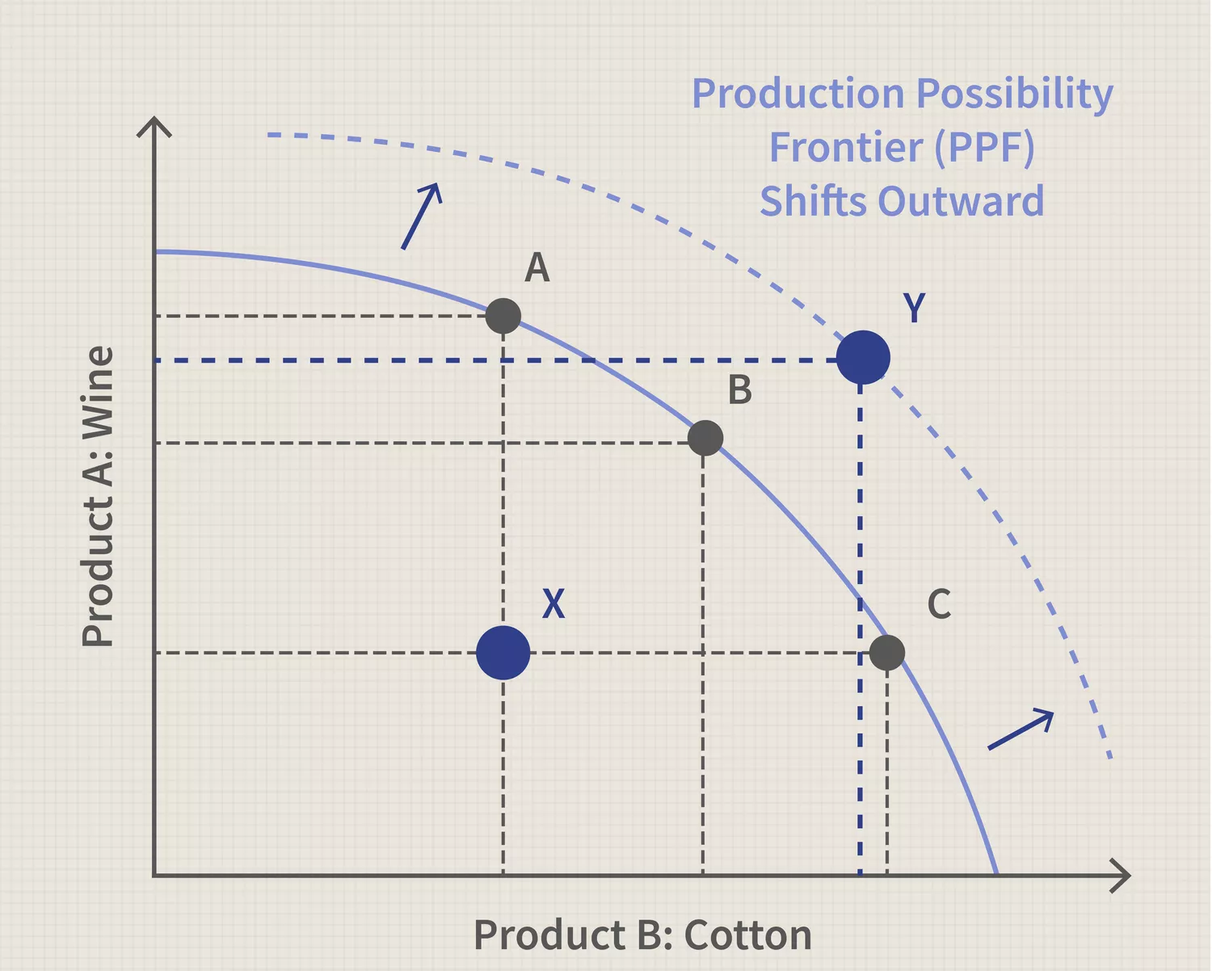

Slide 31
Microeconomics
Definition
Microeconomics studies individual economic units.
It focuses on:
Individual consumers
Individual firms
Individual markets
Price determination

Slide 32
Topics of Microeconomics
Demand and supply
Consumer behavior
Production theory
Cost and revenue
Market structures
Wage determination

Slide 33
Importance of Microeconomics
Helps firms determine prices.
Assists efficient resource allocation.
Explains market behavior.
Supports business decision making.

Slide 34
Macroeconomics
Definition
Macroeconomics studies the economy as a whole.
It focuses on:
National income
Inflation
Unemployment
Economic growth
Monetary policy
Fiscal policy

Slide 35
Topics of Macroeconomics
GDP and national income
Inflation
Unemployment
Economic growth
International trade
Balance of payments

Slide 36
Importance of Macroeconomics
Helps government policy formulation.
Maintains economic stability.
Promotes economic growth.
Controls inflation and unemployment.

Slide 37
Difference Between Microeconomics and Macroeconomics
Microeconomics | Macroeconomics
Studies individual units | Studies economy as a whole
Focuses on individual prices | Focuses on general price level
Studies individual markets | Studies aggregate markets
Concerned with resource allocation | Concerned with economic stability
Example: Price of rice | Example: National inflation

Slide 38
Relationship Between Micro and Macro Economics
Microeconomics and macroeconomics are interrelated.
Example
Individual spending affects national income.
Firm investment affects economic growth.
Both branches are essential for understanding the economy.

Slide 39
Economic Systems
An economic system is a method by which a society organizes production, distribution, and consumption.
Main Types
Capitalist Economy
Socialist Economy
Mixed Economy

Slide 40
Capitalist Economy
Features
Private ownership
Profit motive
Freedom of enterprise
Market mechanism
Limited government intervention
Examples
United States
United Kingdom

Slide 41
Advantages of Capitalism
Encourages innovation
Efficient resource use
Consumer choice
Competition improves quality

Slide 42
Disadvantages of Capitalism
Income inequality
Monopoly power
Unemployment
Economic instability

Slide 43
Socialist Economy
Features
State ownership
Central planning
Social welfare objective
Limited private property
Example
Former Soviet Union (USSR)

Slide 44
Advantages of Socialism
Reduces inequality
Ensures social welfare
Provides basic needs
Less exploitation

Slide 45
Disadvantages of Socialism
Less innovation
Weak incentives
Bureaucratic inefficiency
Limited consumer choice

Slide 46
Mixed Economy
Features
Combination of capitalism and socialism
Both private and public sectors exist
Government regulation with market mechanism
Examples
Bangladesh
India
Canada

Slide 47
Advantages of Mixed Economy
Economic freedom with regulation
Balanced growth
Social welfare protection
Reduced market failure

Slide 48
Economics and Engineering
Economics and engineering are closely related.
Engineering projects require:
Cost analysis
Resource allocation
Feasibility studies
Efficiency evaluation
Economics helps engineers make rational decisions.

Slide 49
Importance of Economics for Engineers
1. Cost Minimization
Choose the least costly method.
2. Profit Maximization
Improve productivity and efficiency.
3. Project Evaluation
Analyze costs and benefits.
4. Resource Optimization
Efficient use of labor, materials, and technology.
5. Decision Making
Selection among alternatives.

Slide 50
Engineering Economics
Engineering economics applies economic principles to engineering decisions.
Common Applications
Project appraisal
Investment analysis
Cost-benefit analysis
Break-even analysis
Capital budgeting

Slide 51
Real-Life Examples
Example 1: Bridge Construction
Example 2: Power Plant Selection
Engineers compare:
Cost of materials
Durability
Maintenance cost
Social benefits
Decision between:
Coal plant
Solar plant
Hydroelectric plant
Economic analysis helps identify the best alternative.

Slide 52
Suggested Readings
1. Samuelson, P. A., & Nordhaus, W. D. – Economics
2. Gregory Mankiw – Principles of Economics
3. Lipsey and Chrystal – Economics
4. Alfred Marshall – Principles of Economics
5. Lionel Robbins – An Essay on the Nature and Significance of Economic Science

Slide 53
Questions and Discussion
Thank You

Slide 54
Why should engineers study economics?
Explain the role of cost-benefit analysis in engineering projects.
How does economics assist engineers in resource allocation?
Explain the importance of feasibility studies in engineering decision-making.
What is engineering economics? Mention two practical applications.
Short Questions
Define economics.
What is opportunity cost?
Differentiate between microeconomics and macroeconomics.
What are the central economic problems?
Define mixed economy.
Essay Questions
Discuss the scope and subject matter of economics.
Explain the central economic problems with examples.
Compare capitalist, socialist, and mixed economic systems.
Discuss the importance of economics in engineering.

Slide 55
Questions
Compare Adam Smith's wealth definition and Marshall's welfare definition of economics.
Why is Robbins' scarcity definition considered more comprehensive than earlier definitions?
Explain why economics is called a science of choice.
Distinguish between positive economics and normative economics with suitable examples.
Why is economics regarded as a social science?

Slide 56
Questions
Explain the relationship between production and consumption in economics.
What role does exchange play in economic activities?
Why is distribution considered an important subject matter of economics?
How does public finance contribute to economic development?
Explain the significance of social welfare as a subject matter of economics.

Slide 57
Questions
Why does scarcity give rise to economic problems?
Explain the relationship between scarcity and choice.
What is opportunity cost? Illustrate with a real-life example.
Why is opportunity cost considered a fundamental concept in economics?
Explain how opportunity cost influences individual decision-making.

Slide 58
Questions
Why must every economy answer the question "What to produce?"
Explain the economic significance of the problem "How to produce?"
Why is the problem "For whom to produce?" closely related to income distribution?
Explain the importance of full employment in an economy.
Why is economic growth considered a central economic problem?

Slide 59
Questions
What assumptions underlie the Production Possibility Curve (PPC)?
Why is the PPC generally downward sloping?
Why is the PPC usually concave to the origin?
What does a point inside the PPC indicate?
What does a point outside the PPC represent?
How does the PPC illustrate the concept of opportunity cost?
What happens to the PPC when technological progress occurs?
Explain how economic growth can shift the PPC outward.

Slide 60
Questions
Why are microeconomics and macroeconomics complementary rather than competing branches?
Explain the relationship between individual spending and national income.
Give two examples each of microeconomic and macroeconomic issues.
Why is profit motive important in a capitalist economy?
Explain two major criticisms of a capitalist economy.
Why may innovation be limited in a socialist economy?
Explain how a mixed economy combines the features of capitalism and socialism.
Why is Bangladesh considered a mixed economy?
Compare the role of government in capitalist and socialist economic systems.

Slide 61
Questions
"Unlimited wants and limited resources are the root causes of all economic problems." Explain.
Discuss how opportunity cost influences government policy decisions.
Why might a mixed economy be more suitable for developing countries than a purely capitalist or socialist economy?
Explain how economics helps improve social welfare.
"Every engineering decision is also an economic decision." Explain with examples.
How can technological advancement help solve the problem of scarcity?
Explain why efficient resource allocation is important for economic development.
Why do economists emphasize choice rather than wealth alone?
Discuss the relevance of the PPC in explaining real-world resource allocation decisions.
Explain how economics helps individuals, firms, and governments make rational decisions.

Slide 62
Questions
Draw a Production Possibility Curve and explain its main features.
Using a PPC diagram, illustrate the concept of opportunity cost.
Using a PPC diagram, distinguish between efficient, inefficient, and unattainable production points.
Show with a diagram how economic growth affects the PPC.
Draw a PPC and explain the problem of scarcity using the diagram.

